Slide 1
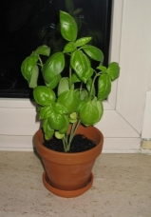
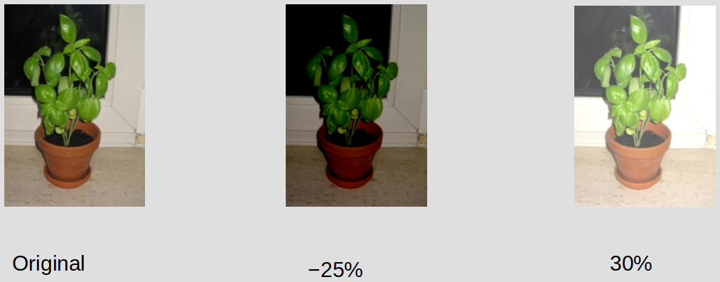
Original
−25%
30%
Screenshot LibreOffice 7

